Slide 1

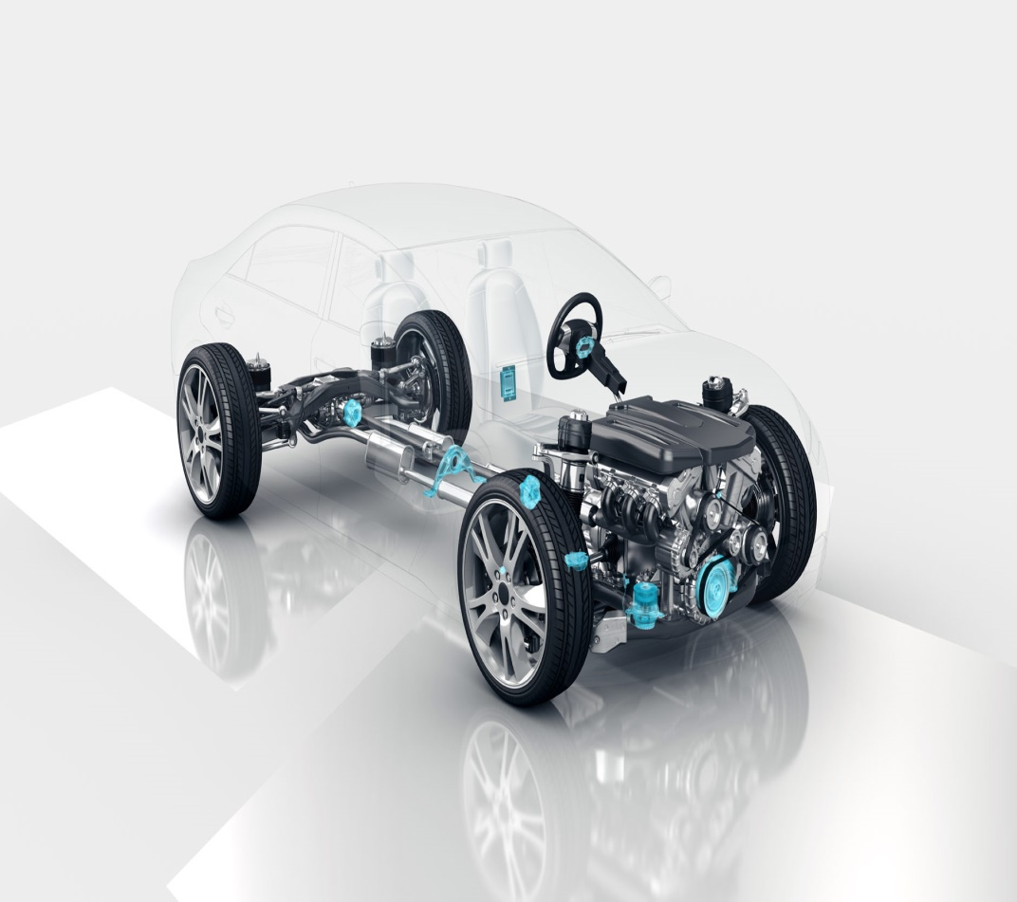
Autonomous Vehicle Group
School of ECE
Pedestrian Detection
Mini Project Review-I
Team No: 05
Students Details:
1. Akash Nagappagol USN: 01FE19BEC177
2. Sumedh Nilakhe USN: 01FE19BEC178
3. Nitin Mogare USN: 01FE19BEC181
4. Chaitanya Inamadar USN:01FE19BEC192
Guide Details:
Prof. Basavaraj Patil

Slide 2
Autonomous Vehicle Group
School of ECE
Contents :
Introduction
Need Statement
Problem Statement
Literature Survey
Multiple Solution
Functional block diagram
Dataset /Data Acquisition
Gantt Chart
References

Slide 3
Autonomous Vehicle Group
School of ECE
Introduction
What is an Autonomous Vehicle?
An autonomous car is a vehicle that is capable of sensing its environment and moving safely with little or no human input
Self-driving cars combine a variety of sensors to perceive their surroundings, such as radar, lidar, sonar, GPS etc.
Significance of Pedestrian Detection :
Pedestrian detection is an essential and significant task in an autonomous vehicle system. It has an obvious extension to autonomous applications due to potential for improving safety systems. Many car manufacturers are trying to implement these things in their car e.g : Tesla,Mercedes etc.

Slide 4

Autonomous Vehicle Group
School of ECE
Need Statement
The foundation of AV technology is effective detection. Before vehicles can understand and respond to their surroundings, they must be able to detect important road elements, including pedestrians.
In order to prevent accidents from happening the world is currently shifting towards Autonomous Vehicles in which one of the major aspect is to predict the obstacles that may come across the vehicle. So, in this project we are mainly focusing on detecting the pedestrians.

Slide 5
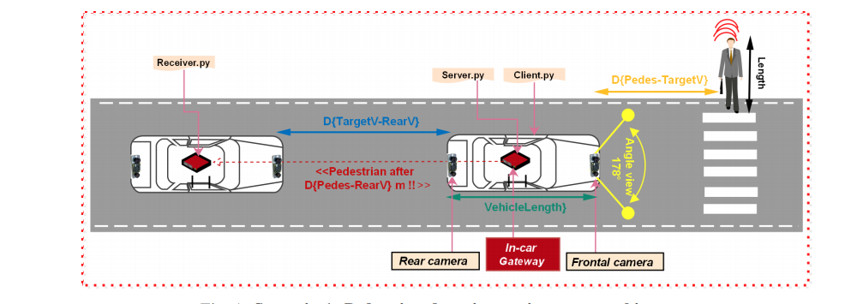
Autonomous Vehicle Group
School of ECE
Problem Statement :
Implement an algorithm to detect pedestrians visible in the camera input frame using image recognition.

Slide 6
Autonomous Vehicle Group
School of ECE
Literature Survey
Sl. No. | Authors | Paper title | Publication details | Methodology | Outcomes of the paper
1. | MP Nkosi , GP Hancke and RMA dos Santos | Autonomous Pedestrian Detection | 2015 IEEE | HOG and Kalman filter | In this paper, HOG Descriptor is used as an detector along with two tracking algorithms Kalman and Particle Filter
2. | Amal Hbaieb , JiheneRezgui , Lamia Chaari . | Pedestrian Detection for Autonomous Driving within Cooperative Communication System | 2019 IEEE Wireless Communications and Networking Conference (WCNC) | HOG descriptor SVM classifier Haar descriptor | In this paper, HOG Descriptor with linear SVM is used for pedestrian detection and Haar feature-based cascade classifier to reach vehicle detection.
3. | Rajkumar Soundrapandiyan P. V. S. S. R. Chandra Mouli | An Approach to Adaptive Pedestrian Detection and Classification in Infrared Images Based on Human Visual Mechanism and Support Vector Machine | Received: 14 February 2017 / Accepted: 7 June 2017 © King Fahd University of Petroleum & Minerals 2017 | Morphological Processing | In this paper, a new method for pedestrian detection in IR images using human visual mechanism and support vector machine is proposed

Slide 7
Autonomous Vehicle Group
School of ECE
Literature Survey
Sl. No. | Authors | Paper title | Publication details | Methodology | Outcomes of the paper
4. | Zhiheng Yang, Jun Li, and Huiyun Li, Member, IEEE | Real-time Pedestrian and Vehicle Detection for Autonomous Driving | 2018 IEEE Intelligent Vehicles Symposium (IV) Changshu, Suzhou, China, June 26-30, 2018 | extratcting the visual features from the area Such as Harr features commonly used in face detection; HOG features commonly used in pedestrian detection and ordinary target detection | In this paper, OpenCV for the implementation of pedestrian detection also, a low-dimensional soft- output SVM pedestrian classifier to implement precise pedestrian detection.
5. | Gonzalez and Woods | Digital Image Processing | 2008 by Pearson Education ,Inc Pearson Prentice Hall | ----------------------- | Image processing Basics explained.
6. | A.K. Jain | Fundamentals of Digital Image Processing | (Prentice Hall Information and System Sciences Series) Paperback – Import, 23 September 1988 | ---------------------- | Image processing Basics explained.

Slide 8
Multiple Solutions:
Autonomous Vehicle Group
School of ECE
Sobel Filter
Averaging Filter
Gaussian Filter
Median Filter
Sharpening Filter

Slide 9
Automotive Electronics Group
School of ECE
Functional Block Diagram
Pre-processing of Image data
Image captured n
Converting image into grayscale Image
Detecting object in Data Set
Classifying between Object and Pedestrian
Mark the pedestrian
Identifying the parts from the filtered image and detecting them

Slide 10
Automotive Electronics Group
School of ECE
Functional Block Diagram
Phase 1 :
Image segmentation
Captured Image
Gray scaling
Sobel filter
Edge detected segment of Image

Slide 11
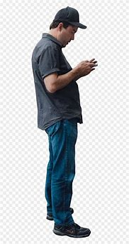
Data set / Data Acquisition
Autonomous Vehicle Group
School of ECE
The Data set is an Image which we have acquired from Internet.
The Captured image is (RGB) is converted to Gray-scale image.

Slide 12
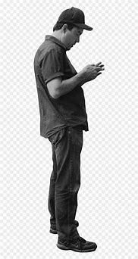
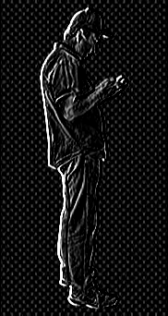
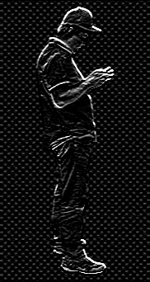
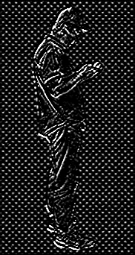
Original Image
Grayscale Image
Sobel-X Image
Sobel-Y Image
Final Output
Image

Slide 13

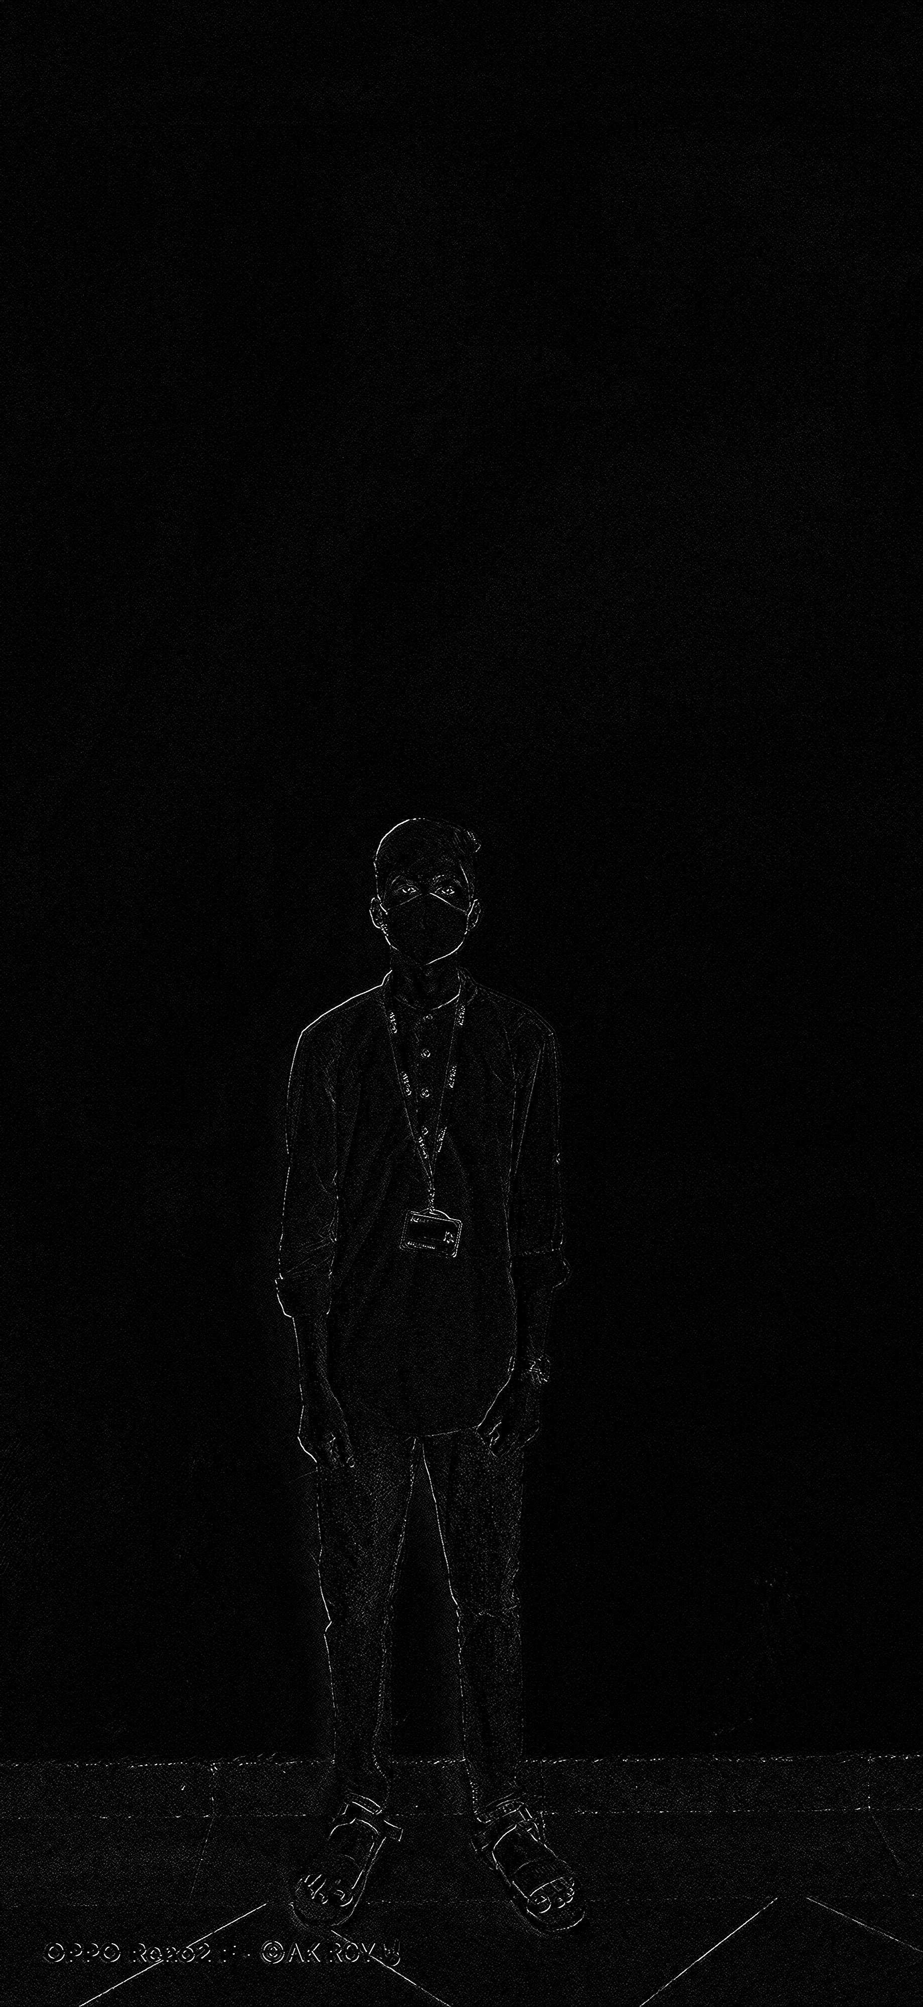
Autonomous Vehicle Group
School of ECE

Slide 14
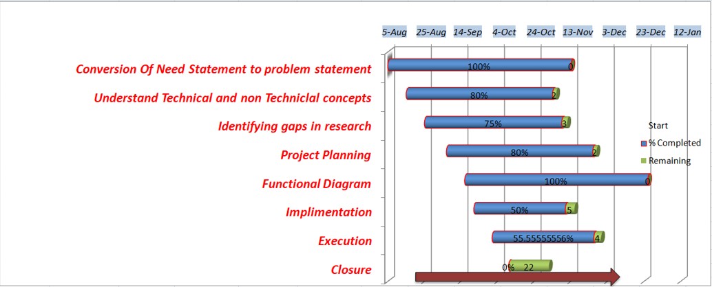
Gantt Chart:
Autonomous Vehicle Group
School of ECE

Slide 15
[1] Digital Image Processing – “Gonzalez and Woods"; [2] "Fundamentals of Digital Image Processing - A.K. Jain“. [3] MP Nkosi , GP Hancke and RMA dos Santos “Autonomous Pedestrian Detection –” 2015 IEEE, MP Nkosi , GP Hancke and RMA dos Santos”. [4] Zhiheng Yang, Jun Li, and Huiyun Li, Member, IEEE - “Real-time Pedestrian and Vehicle Detection for Autonomous Driving” 2018 IEEE Intelligent Vehicles Symposium (IV) Changshu, Suzhou, China, June 26-30, 2018 [5] Amal Hbaieb , JiheneRezgui , Lamia Chaari . “Pedestrian Detection for Autonomous Driving within Cooperative Communication System.” 2019 IEEE Wireless Communications and Networking Conference (WCNC)
Autonomous Vehicle Group
School of ECE
References

Slide 16
Autonomous Vehicle Group
School of ECE
Thank You

